Slide 1

CIST 2931, Fall 2016 Weekly Report #1 10/03/2016
i c i o u s
Cnrl/alt/Delicious
Steven Alcorn, Zachary Weaver, Tyrus Skipper, Antonio Mosquera, Rupa Shrestha
Notes:
Antonio

Slide 2
Tests
i c i o u s
Visual Tests between users
Connection tests between the database
Note Saves, Number of Notes
Different User Saves
Issue in code with transitioning between users
Notes:
Steven

Slide 3
Code
i c i o u s
Changed the case code
AdminForm (presentation layer):
LINE 106 - case 2:
//DCP
tabPane_container.remove(7);
tabPane_container.remove(6);
tabPane_container.remove(3);
tabPane_container.remove(2);
tabPane_container.remove(1);
tabPane_container.remove(0);
break;
case 3:
//Auditor
tabPane_container.remove(7);
tabPane_container.remove(4);
tabPane_container.remove(3);
tabPane_container.remove(2);
tabPane_container.remove(1);
Notes:
Rupa

Slide 4
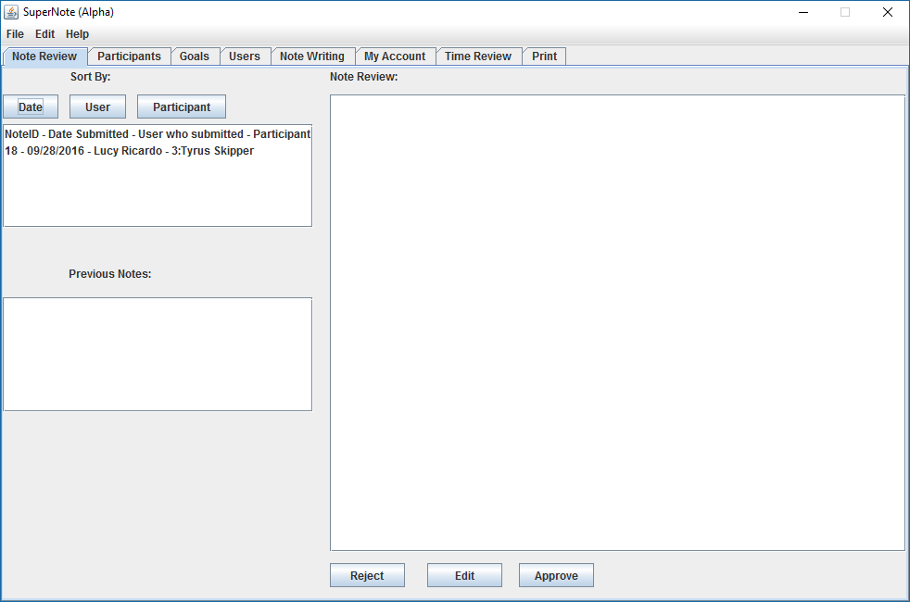
Notes:
Rupa

Slide 5
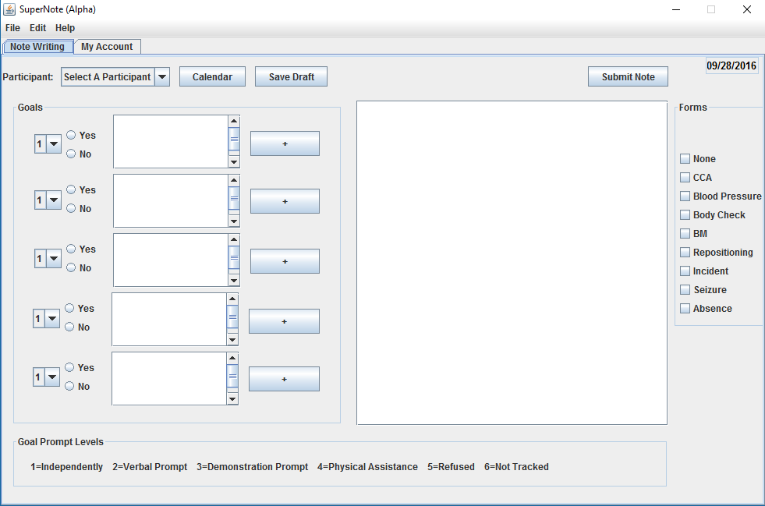
Notes:
Rupa

Slide 6
Project Plan
i c i o u s
Fix the user clause/tabs
DCP and Admin errors for save draft
Fix saving multiple copies of notes
Adds a copy of the note after saving draft
Notes:
Zach, this is just basically describing what we will be working on for the week. I will describe it to you in more detail Monday.

Slide 7
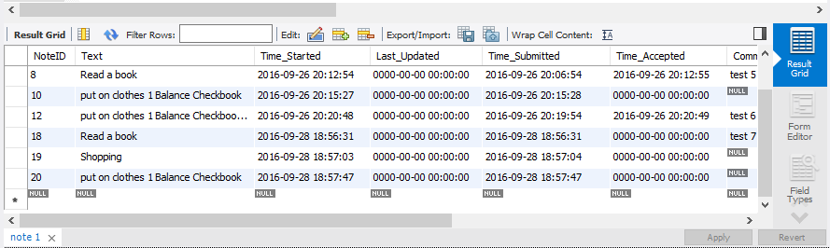
Deliverable
i c i o u s
MySQL Workbench update to Note table
Notes:
Ty

Slide 8
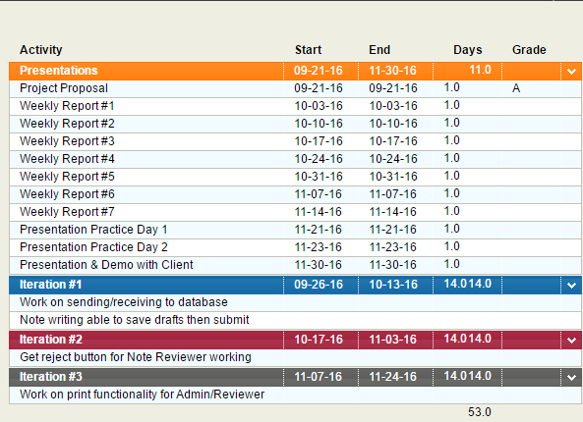
Project Plan for the Semester

